Slide 1

Cyberbullying Detection: An Ensemble Based Machine Learning Approach Kazi Saeed Alam, Shovan Bhowmik, and Priyo Ranjan Kundu Prosun
3rd International Conference on Intelligent Communication Technologies and Virtual Mobile Networks (ICICV 2021)

Slide 2
Outline
Introduction
Literature Review
Proposed Approach and Models
Methodology
Performance Analysis
Future Works & Conclusion
References

Slide 3
Introduction
The rapid growth in the usage of social media platforms has some negative consequences.
People, particularly teenagers are often exposed to Cyberbullying in the form of various behavioral and psychological threats.
Cyberbullying or cyberharassment is a form of bullying or harassment using electronic means.
Thus, Research on cyberbullying detection is gaining increasing attention in recent years as both individual victims and societies are greatly affected by it.

Slide 4
Literature Review
Recently several approaches have been introduced for detecting cyberbullying.
Author | Work | Limitation
Dalvi et al.[2020] | -used SVM and Naive Bayes as classifier. | -low accuracy with only 71.25% and 52.70%
Talpur et al.[2020] | -feature based system to detect the magnitude of cyberbullying | -improved accuracy of 93% but dataset contains strongly biased positive categories.
Muneer et al.[2020] | -used various classifier models | -accuracy 90.57% however not many feature extraction methods were investigated.
Balakrishnan et al.[2020] | -used Random Forest, Naive Bayes and J48 | -imbalanced dataset -can’t detect sarcasm contents
Our Proposed Model | -uses single and double level ensemble techniques | -accuracy over 94% -various feature extraction and cross-validation techniques are investigated

Slide 5
Proposed Approach and Models
Dataset Description:
For our work, we have used an already created benchmark dataset containing around 10,000 tweets, both offensive and non-offensive.
Tweets that are non-offensive are labeled as ’0’ and the offensive ones are labeled as ’1’.
4164 tweets are labeled as non-offensive (45.8%) and the remaining 4929 tweets are tagged as offensive (54.2%).
The cleaned labeled dataset has been split into a train (80%) and a test set (20%).

Slide 6
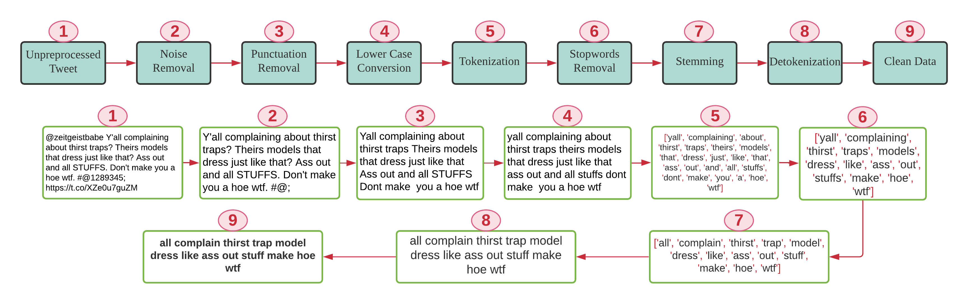
Proposed Approach and Models(cont.)
Data Preprocessing:

Slide 7
Proposed Approach and Models(cont.)
Feature Extraction: One of the challenges of text categorization is learning from high dimensional data. Thus, it is best to perform feature reduction to reduce the text feature. Two different features selection methods are used:
Bag of Words(BoW): It takes each tweet as input and calculates the number of occurrences of each word in that tweet, which then generates a numerical representation of the text known as vector features of fixed length.
Term Frequency-Inverted Document Frequency (TF-IDF): It is a statistical metric used to measure how important a term is to a document in a dataset. it weights down the term frequency while scaling up the rare ones.

Slide 8
Proposed Approach and Models
N-gram Model: N-gram modeling is a popular feature identification and analysis approach used in language modeling and Natural language processing fields.
It is a contiguous sequence of items with length n.
It could be a sequence of words, bytes, syllables, or characters.
In this work, we have used character and word based n-gram to represent the context of the document and generate features to classify the tweets.
The idea is to generate various sets of n-gram frequency profiles from the training data to represent offensive and non-offensive tweets..

Slide 9
Proposed Approach and Models(cont..)
Classification Process:
In our work, we have compared the performance of four machine learning classifiers, namely, Multinomial Naive Bayes (MNB), Logistic Regression (LR), Decision Tree Model (DT), Linear Support Vector Classifier (LSVC).
We have also checked the performance of three Ensemble strategies known as Gradient Boosting Classifier (GBoost), AdaBoost(AdB) and Bagging.
Finally we have implemented a Single Level Ensemble Model (SLE) and a Double Level Ensemble Model (DLE) architecture to automatically identify posts and classify them into two groups as ‘offensive’ and ‘non-offensive’.

Slide 10
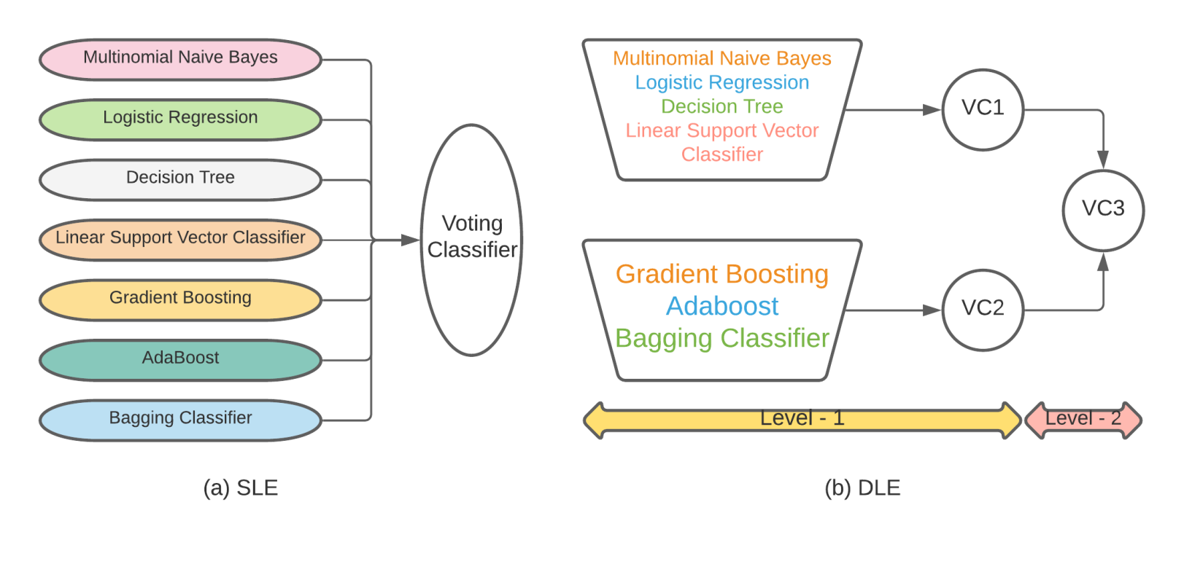
Proposed Approach and Models(cont..)
Classification Process:

Slide 11
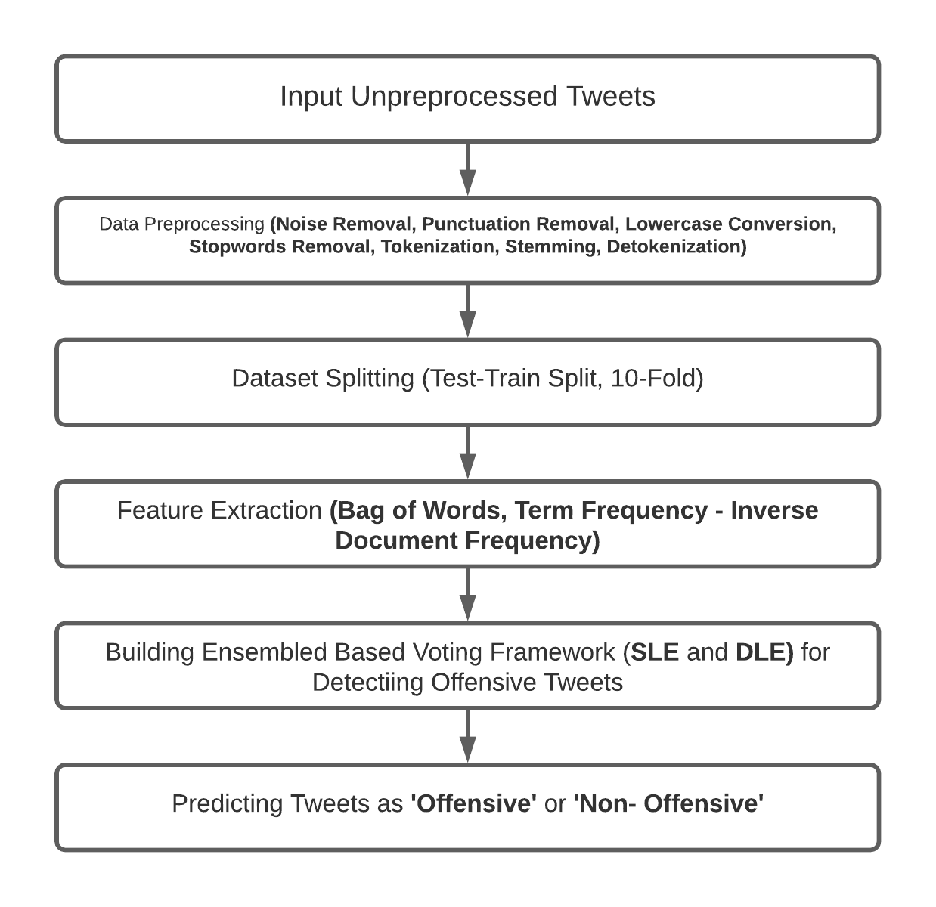
Methodology

Slide 12
Performance Analysis
Single Level Ensemble (SLE):
We have achieved 94% accuracy when TF-IDF (‘Word’ and ‘Unigram’) is used and 70% accuracy has been attained when TF-IDF (‘Bi-gram’) features are retrieved which have surpassed the performance of other existing models.
Double Level Ensemble (DLE):
Though SLE has achieved higher performance than DLE, for TF-IDF(‘Bigram’), DLE has achieved 75% accuracy which is greater than SLE.

Slide 13
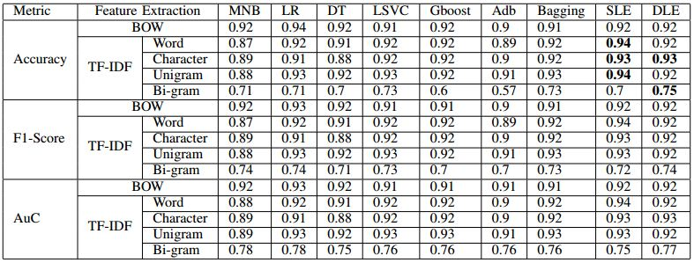
Performance Analysis(cont.)
Comparative analysis of various classifiers based on performance evaluation:

Slide 14
Performance Analysis (cont.)
The existing prediction accuracy varied from 52% to 90% which is overcome in our proposed model.
To prevent our model from bias, we have also validated our model by applying different cross-validation techniques (K-Fold, Stratified K-Fold, Shuffle Split, Stratified Shuffle Split). (K=10)
We have reached 95% to 96% accuracy in the case of SLE and DLE respectively for all the features except ‘Bigram’ when the K-Fold cross-validation technique has been applied.
The highest 83% accuracy has been attained for TF-IDF (‘Bi-gram’) when Stratified K-Fold technique has been applied for SLE and Stratified Shuffle Split has yielded 79% accuracy for DLE.

Slide 15
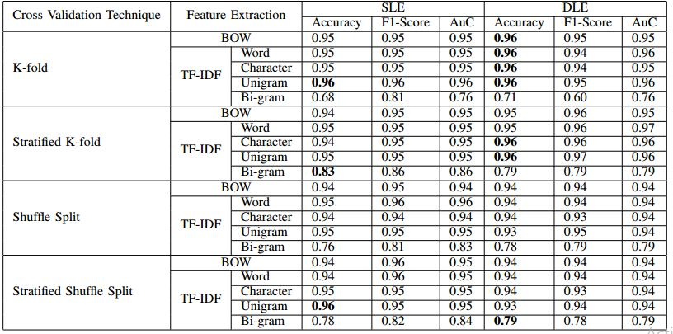
Performance Analysis(cont.)
Performance evaluation of SLE and DLE model based on cross-validation techniques:

Slide 16
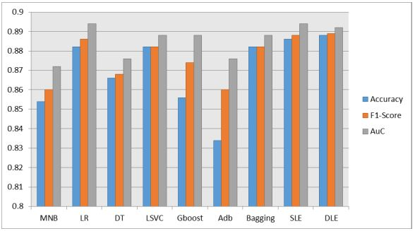
Performance Analysis (cont.)
Therefore, SLE and DLE can be a good approach to carry out the best result in the state of art.
Taking the average performance for all the feature extraction techniques, a performance summary has been shown here.

Slide 17
Conclusion & Future Works
Cyberbullying are continuously affecting individuals and society that can lead to serious consequences even suicidal thoughts among the victims.
Our proposed SLE and DLE models outperformed all the independently applied ML algorithms and ensemble techniques achieving the highest 96% accuracy for the twitter extracted dataset.
In future, we will apply our models to more diversified datasets.
It would also be great to extend and examine if the proposed model can work for the multi-class classification problem too.
Our suggested models can be applied in other related text classification works for further meaningful analysis.

Slide 18
References
1. Anna Schmidt & Michael Wiegand. (2017). A Survey on Hate Speech Detection using Natural Language Processing. 1-10. 10.18653/v1/W17-1101.
2. Gengfeng Niu, Jing he, Shanyan Lin, Xiaojun Sun and Claudio Longo-bardi. 2020. ”Cyberbullying Victimization and Adolescent Depression:The Mediating Role of Psychological Security and the Moderating Role of Growth Mindset” Int. J. Environ. Res. Public Health 17, no. 12: 4368.
3. Abigail Geiger, “How and why we studied teens and cyberbullying,” Pew Research Center, 2018. [Online]. Available:http://www.pewresearch.org/fact-tank/2018/09/27/qa-how-and-why-westudied-teens-and-cyberbullying/. 4. R. R. Dalvi, S. Baliram Chavan and A. Halbe, ”Detecting A Twitter Cyberbullying Using Machine Learning,” 2020 4th International Conference on Intelligent Computing and Control Systems (ICICCS), Madurai, India, 2020, pp. 297-301, doi: 10.1109/ICICCS48265.2020.9120893.
5. Shan Suthaharan, ”Machine learning models and algorithms for big data classification.” Integr. Ser. Inf. Syst 36 (2016): 1-12.
6. Mucahid Mustafa Saritas and Ali Yasar. ”Performance analysis of ANN and Naive Bayes classification algorithm for data classification.” Inter-national Journal of Intelligent Systems and Applications in Engineering7.2 (2019): 88-91.
7. Nabi Rezvani and Alireza Tabebordbar. ”Linking Textual and Contextual Features for Intelligent Cyberbullying Detection in Social Media.”
8. Bandeh Ali Talpur and Declan O’Sullivan. ”Multi-Class Imbalance in Text Classification: A Feature Engineering Approach to Detect Cyber-bullying in Twitter.” Informatics. Vol. 7. No. 4. Multidisciplinary Digital Publishing Institute, 2020.
9. Amgad Muneer and Suliman Mohamed Fati. ”A Comparative Analysis of Machine Learning Techniques for Cyberbullying Detection on Twit-ter.” Future Internet 12.11 (2020): 187.
10. Vimala Balakrishnan, Shahzaib Khan, and Hamid R. Arabnia. ”Improving cyberbullying detection using Twitter users’ psychological features and machine learning.” Computers & Security 90 (2020): 101710.
11. Mahen Herath, Thushari Atapattu, Hoang Dung, Christoph Treude, and Katrina Falkner. 2020. ”AdelaideCyC at SemEval-2020 Task 12:Ensemble of Classifiers for Offensive Language Detection in Social Media. In Proceedings of SemEval”.
12. Nijia Lu, Guohua Wu, Zhen Zhang, Yitao Zheng, Yizhi Ren, and Kim-Kwang Raymond Choo. ”Cyberbullying detection in social media text based on character-level convolutional neural network with shortcuts. ”Concurrency and Computation: Practice and Experience (2020): e5627.
13. Rashi Shah, Srushti Aparajit, Riddhi Chopdekar, and Rupali Patil.”Machine Learning based Approach for Detection of Cyberbullying Tweets.” International Journal of Computer Applications 975: 8887.
14. T. T. A. Putri, S. Sriadhi, R. D. Sari, R. Rahmadani, and H. D.Hutahaean. ”A comparison of classification algorithms for hate speech detection.” In IOP Conference Series: Materials Science and Engineering, vol. 830, no. 3, p. 032006. IOP Publishing, 2020.
15. I. Alanazi, & J. Alves-Foss (2020). Cyber Bullying and Machine Learning: A Survey. International Journal of Computer Science and Information Security (IJCSIS), 18(10).
16. Thomas Davidson, Dana Warmsley, Michael Macy, and Ingmar Weber. ”Automated hate speech detection and the problem of offensive language.” In Proceedings of the International AAAI Conference on Web and Social Media, vol. 11, no. 1. 2017.

Slide 19
Thank You

